Slide 1

WEATHER APP
Pratham Pise 20104069
Pratik Pandit 21204009
Rohan Bait 21204008
Project Guide
Ms. Charul Singh

Slide 2
Contents
Introduction
Objectives
Scope
Literature Survey
Proposed System
Project Outcomes
Block Diagram
Use Case/DFD
Technology Stack
Suggestions in Review 1
Result and Discussion
Conclusion and Future Scope
References

Slide 3
1. Introduction
Weather forecasting is the application of science and technology to predict the state of the atmosphere for a given location.
Weather apps are your ideal companion when it comes to having an estimate of the weather.
This Weather Monitor App provides the user with real time weather information.
This system is dynamic and updated on an hourly basis thus allowing to keep up with the ever-changing weather.

Slide 4
2. Objectives
The prime objective of weather app is the ability to display the weather minute basis accurately, hourly, daily & weekly.
The user will be checking all the weather information inside on app itself.
To help people prepare if they need to take extra gear to prepare for the weather(i.e.umbrella, raincoat, sun-screen, cap, sweater, etc).
To help people know how the local air quality impacts their health.

Slide 5
3. Scope
Can be useful for user to know the climate behaviour all over the world with a single click.
Can be useful for user to easily figure out the conditions of the environment.
Can check for every location on planet.
Can check Air Quality for entered location.

Slide 6
4. Literature Survey
Study found out on Weather Application:
B.K.Agrawal (1980) explained the phenomena for time series regression models for cultivation of rice in Raipur district.
Kuo Sunn (1993) used such application used for intervention model for average 10 days forecast.
Present day scientists use this to predict and warn about how natural disasters caused by abrupt climatic conditions.

Slide 7
4. Literature Survey
Study found out on Weather Application:
Dark Sky Weather App: Dark Sky was a popular iOS-only app for a long time, but it’s available on Android now too.
AccuWeather Weather App: AccuWeather is one of the most well-known names in the weather game. The app has more features than you can shake a stick at.
Google Weather App: Google has provided this free application to predict weather.

Slide 8
5. Proposed System
The system comprises of 1 major module with their sub-modules as follows:
User :
1. Real Time Weather :
Show current weather for current location with appropriate
information & graphic.
2. Change Location :
Search weather for different country/cities/choosing search.
3. Hourly Weather Information :
Hourly weather information for today & daily for a week.
4. Air Quality Index :
Predicting Air Quality based on city.

Slide 9
6. Outcome of Project
User can view the current, future and as well as past weather conditions.
Moreover, this system works globally thereby proving to be an extremely efficient tool for both tourists, as well as frequent travelers.
Provide real time weather application.
Provide accurate Air Quality Index

Slide 10



7. Block Diagram
Weather App
User
Web
Application
Database
Open Weather API

Slide 11
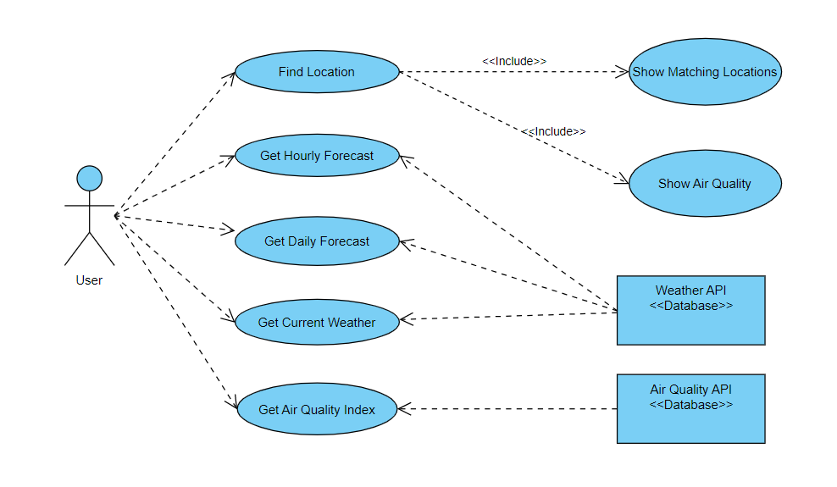
8. Use Case/Diagram

Slide 12



9. Technology Stack
Frontend:
React JS
Backend:
API - OpenWeather
Tools:
VS Code (Visual Studio Code)

Slide 13
Suggestions in Review-1
To add Air Quality Index for report generation.
To add Fahrenheit with Celsius.

Slide 14
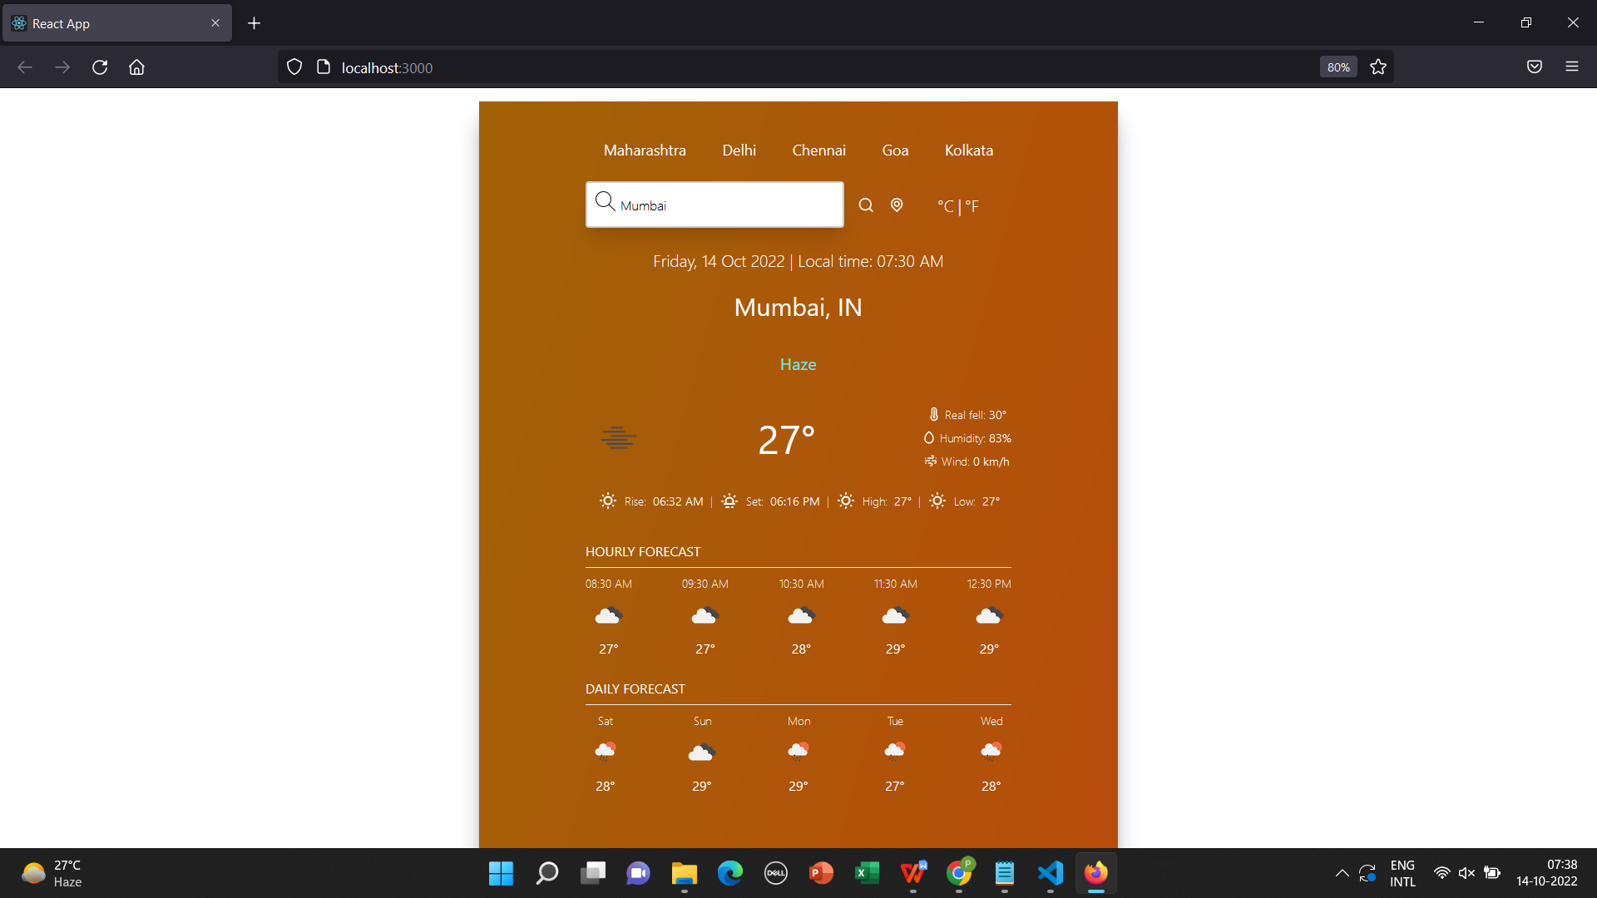
Result and Discussion

Slide 15
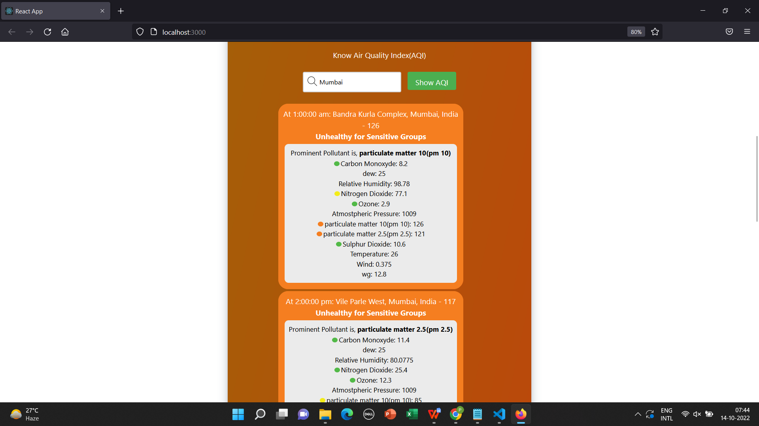
Result and Discussion

Slide 16

Result and Discussion

Slide 17
Conclusion and Future Scope
Providing realtime wind flow through maps.
Developing of advanced systems for severe weather events is ongoing in several countries.
Weather predictions in smart farming.

Slide 18
References
https://www.octalsoftware.com/blog/weather-forecast-alert-app-development/
https://www.irjet.net/archives/V8/i3/IRJET-V8I3355.pdf
https://nevonprojects.com/real-time-global-weather-monitoring-app/
https://openweathermap.org/api
https://aqicn.org/api/

Slide 19
Thank You...!!

